Slide 1
Not (Wheel on Ground)
Start
On Ground
Joystick button
activated (L or R)
True
Wheel on
Ground
Joy Control
Triangle button pressed (1)
Autonomous Mode
Bumper activated
Obstacle detected
Retreat
Change Direction
Not(Bumper)
Rotate
Bumper
activated
Not(Obstacle)
Rotation
is over
Stop
Robot is
stopped

Slide 2
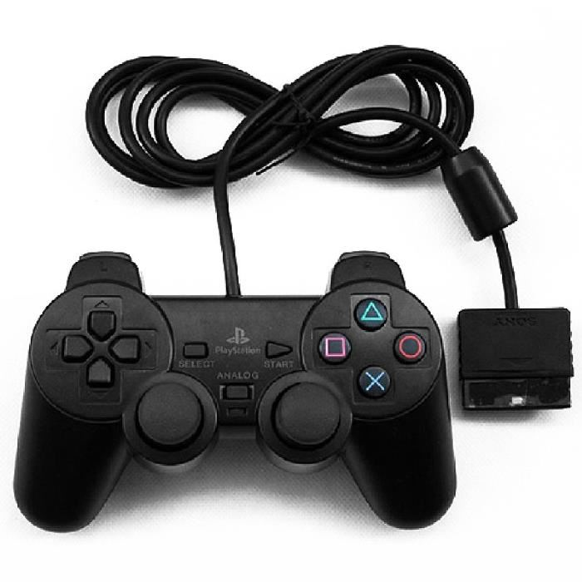
Joy Control
To
Autonomous
Mode
Forward
Backward
Anti-Clockwise
Rotation
Clockwise
Rotation
Joysticks : at anytime, return to Joy Control

Slide 3
Autonomous Mode
Robot go Forward
An obstacle is
less than a meter
Something
touched
a bumper
To Change Direction
To Retreat

Slide 4
Something
touched
a bumper
Robot go Backward & Start Counter
Retreat
Nothing touched
Bumpers & Counter > 5
To Rotate

Slide 5
Rotate
Bumper left
activated
Bumper middle
or
right activated
Clockwise Rotation
Anti-Clockwise Rotation
Imu orientation
changed
by 0,6 radians
To Stop

Slide 6
Stop the robot
Stop
Imu velocity = 0
To Autonomous Mode

Slide 7
Change Direction
Obstacle Detected
Find a
free space
Free Space
In front
Free Space
on Right
Free Space
on Left
No Free
Space
Clockwise Rotation
Anti-Clockwise Rotation
Half turn
No Obstacle
Detected
No Obstacle
Detected
No Obstacle
Detected
Something
touched
a bumper
To Autonomous Mode
To Retreat

Slide 8
At anytime, if
Wheels isn’t
on Ground
Robot is Stopped
Wheels is
on Grond
On Ground
To Joy Control

